Slide 1
Properties of continuous Fourier Transforms

Slide 2
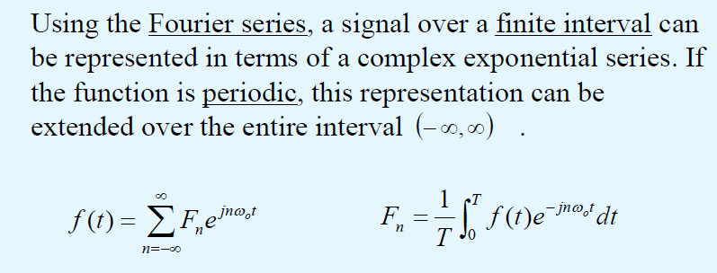
Fourier Transform Notation
For periodic signal

Slide 3
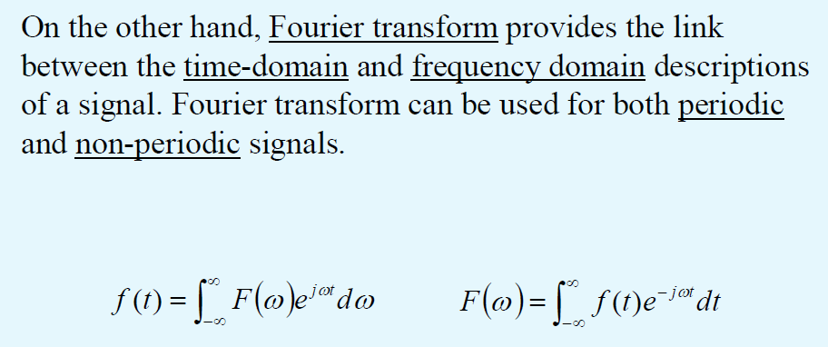
Fourier Transform can be used for BOTH time and frequency domains
For non-periodic signal

Slide 4
FFT for infinite period

Slide 5
Example: FFT for infinite period
If the period (T) of a periodic signal increases,then:
  the fundamental frequency (ω_{o} = 2π/T) becomes smaller and
  the frequency spectrum becomes more dense
  while the amplitude of each frequency component decreases.
The shape of the spectrum, however, remains unchanged with varying T.
Now, we will consider a signal with period approaching infinity.
Shown on examples earlier

Slide 6
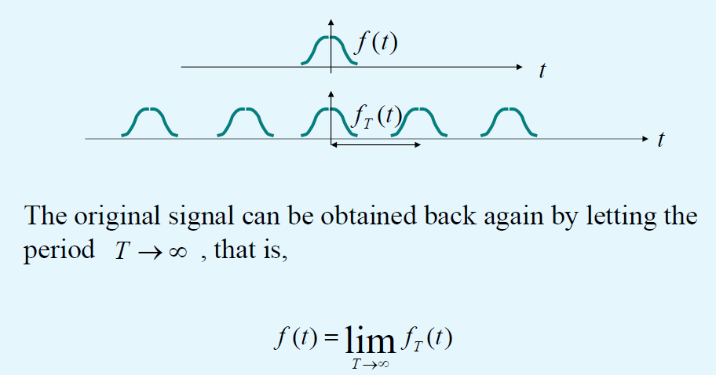
construct a new periodic signal f_{T}(t) from f(t)
Suppose we are given a non-periodic signal f(t).
In order to applying Fourier series to the signal f(t), we construct a new periodic signal f_{T}(t) with period T.
The original signal f(t) can be obtained back

Slide 7
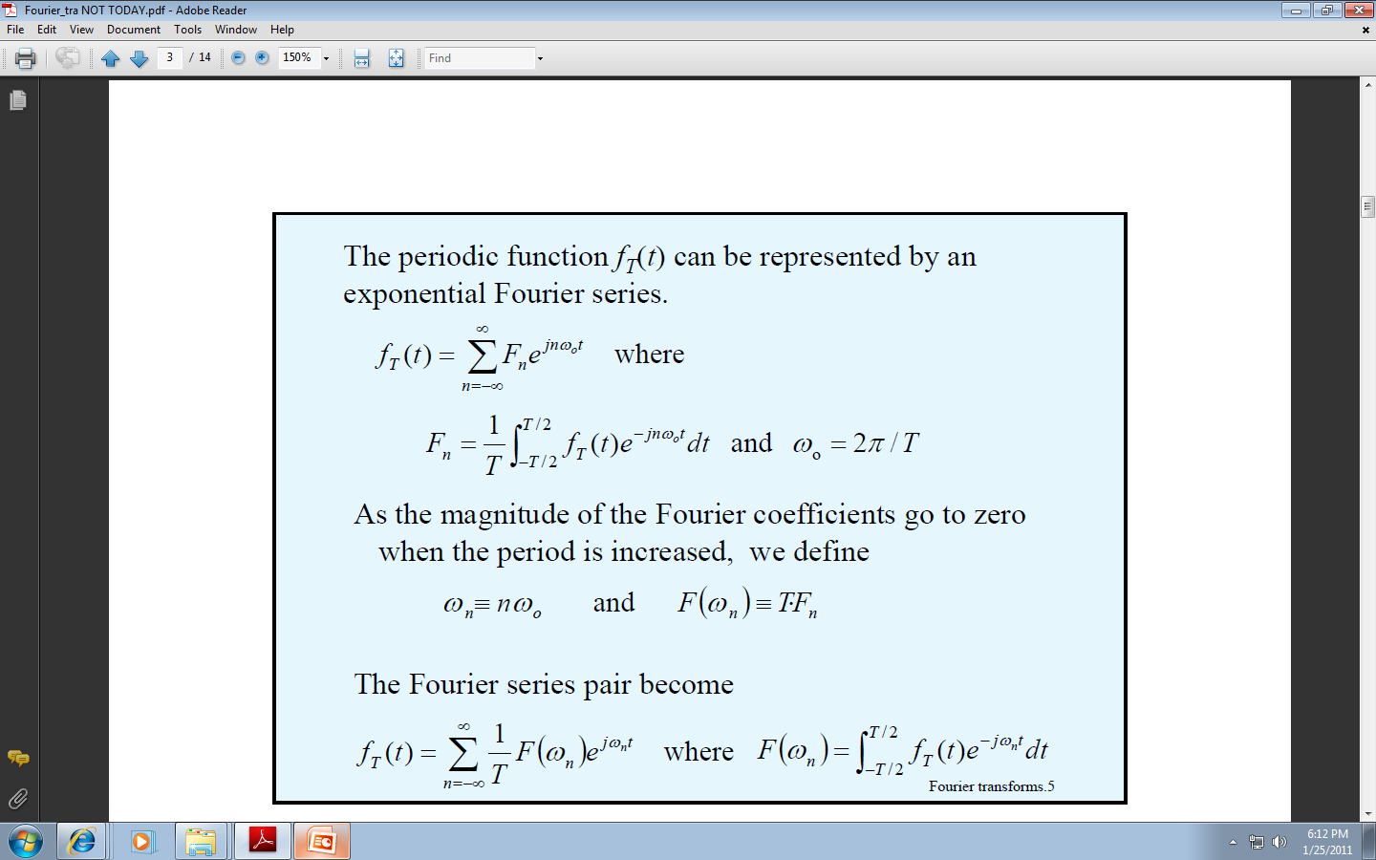
The periodic function f_{T}(t) can be represented by an exponential Fourier series.
Now we integrate from –T/2 to +T/2
period

Slide 8
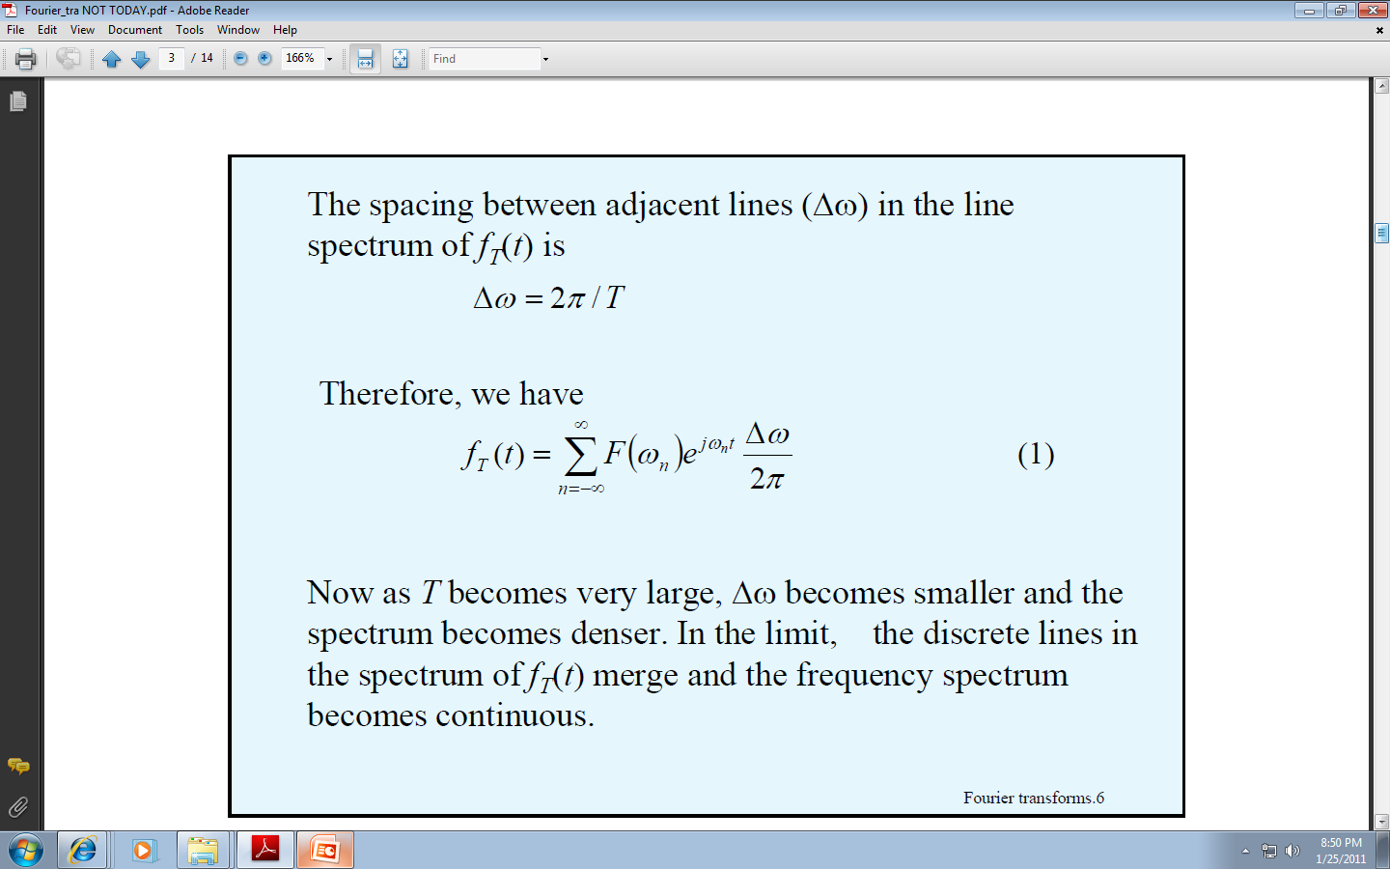
How the frequency spectrum in the previous formula becomes continuous

Slide 9
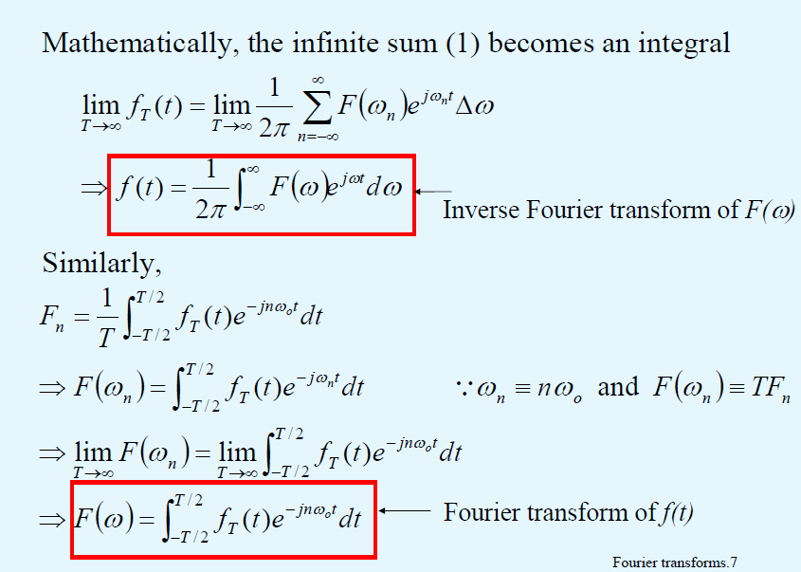
Infinite sums become integrals…
Fourier for infinite period

Slide 10
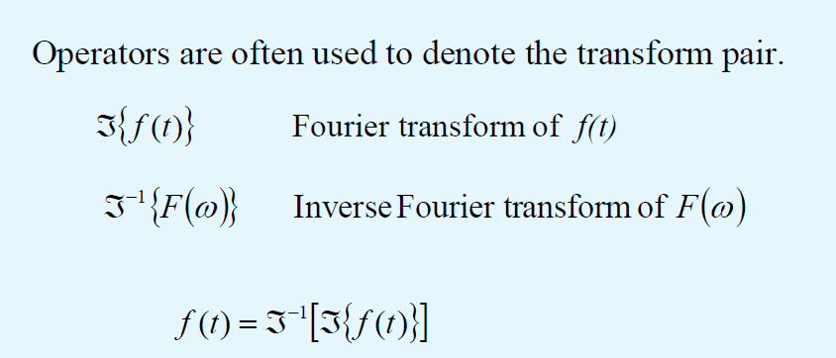
Notations for the transform pair
Finite or infinite period

Slide 11
Singularity functions

Slide 12
Singularity functions
– Singularity functions is a particular class of functions which are useful in signal analysis.
– They are mathematical idealization and, strictly speaking, do not occur in physical systems.
– Good approximation to certain limiting condition in physical systems.
For example, a very narrow pulse

Slide 13
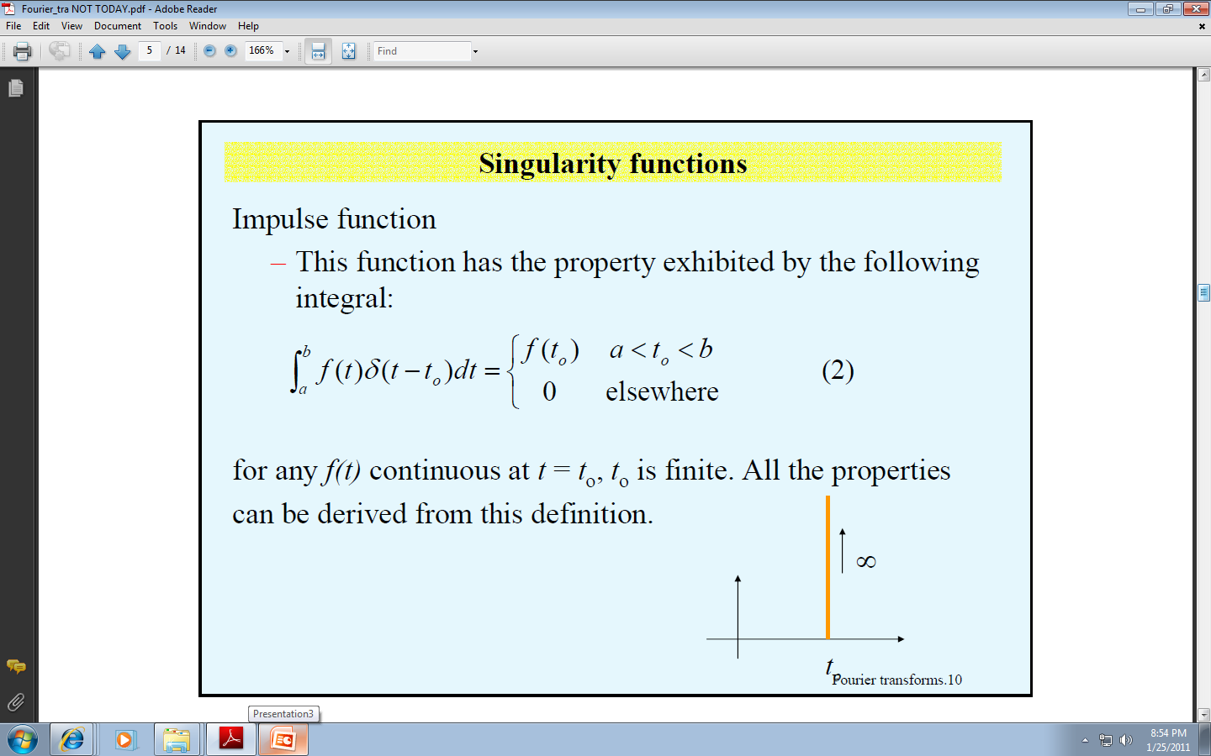
Singularity functions – impulse function
t ₀

Slide 14
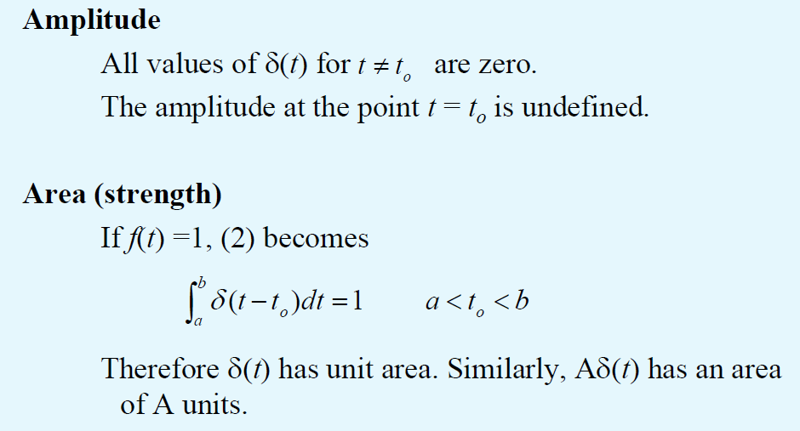
Properties of Impulse functions
Delta t has unit area
A delta t has A units

Slide 15
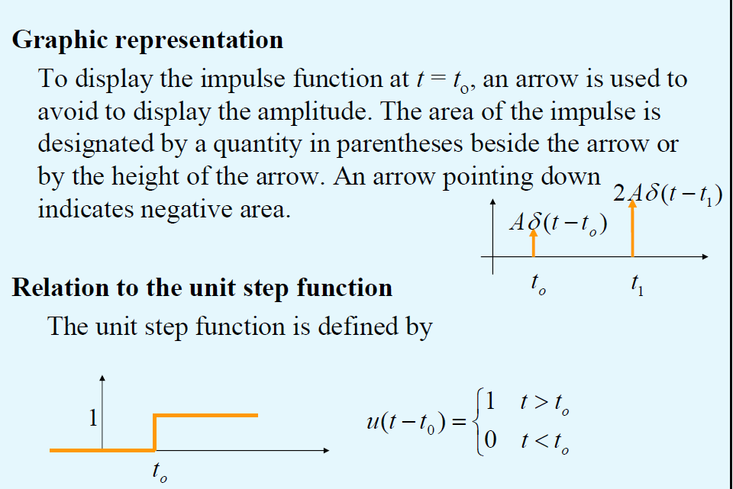
Graphic Representations of Impulse functions
Arrow used to avoid drawing magnitude of impulse functions

Slide 16
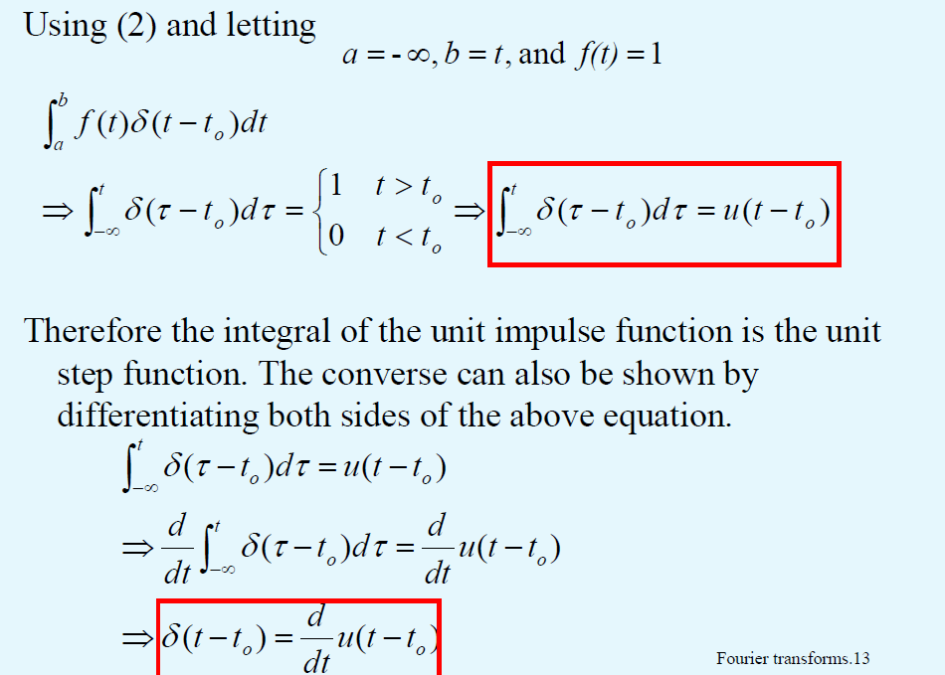
Using delta functions
The integral of the unit impulse function is the unit step function
The unit impulse function is the derivative of the unit step function

Slide 17
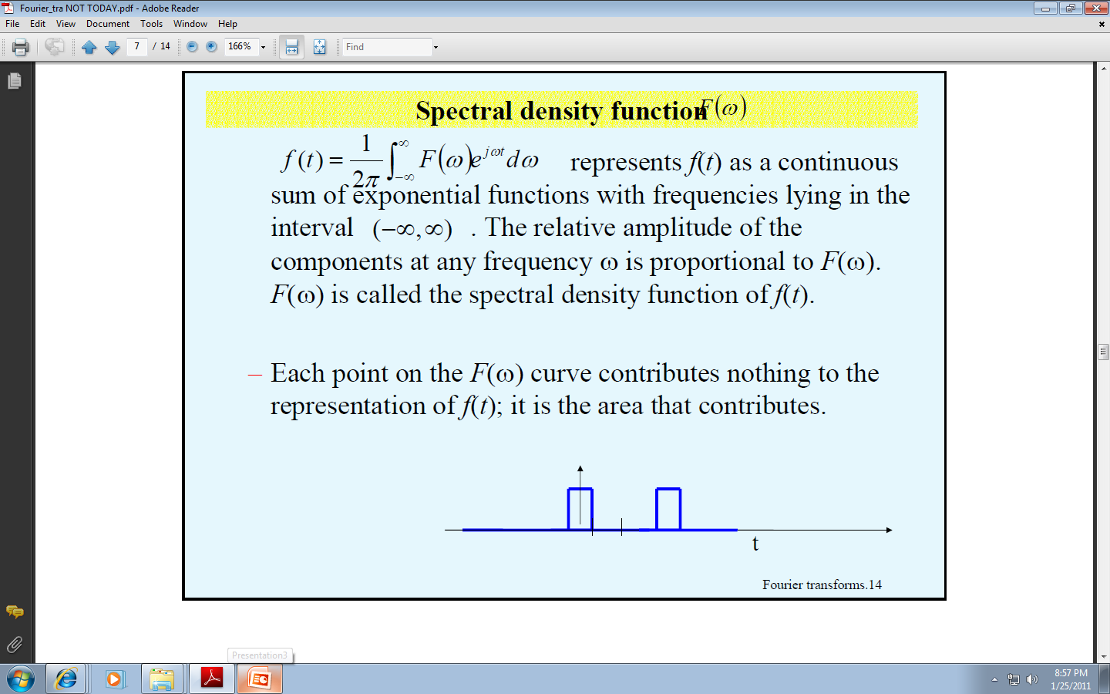
Spectral Density Function F(ω)

Slide 18
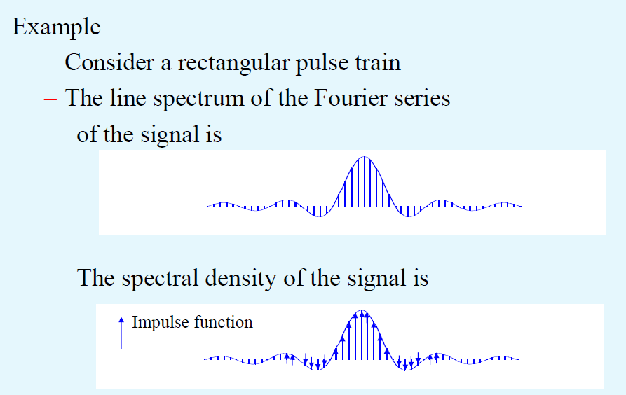
Spectral Density Function F(ω)
Input function

Slide 19
Existence of the Fourier transform for physical systems
We may ignore the question of the existence of the Fourier transform of a time function when it is an accurately specified description of a physically realizable signal.
In other words, physical realizability is a sufficient condition for the existence of a Fourier transform.

Slide 20
Parseval’s Theorem for Energy Signals

Slide 21
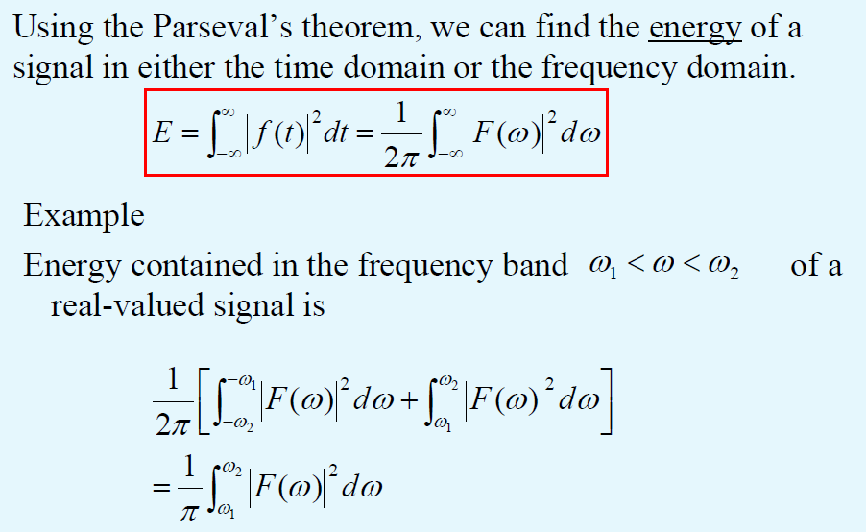
Parseval’s Theorem for Energy Signals
Example of using Parseval Theorem

Slide 22
Fourier Transforms of some signals

Slide 23
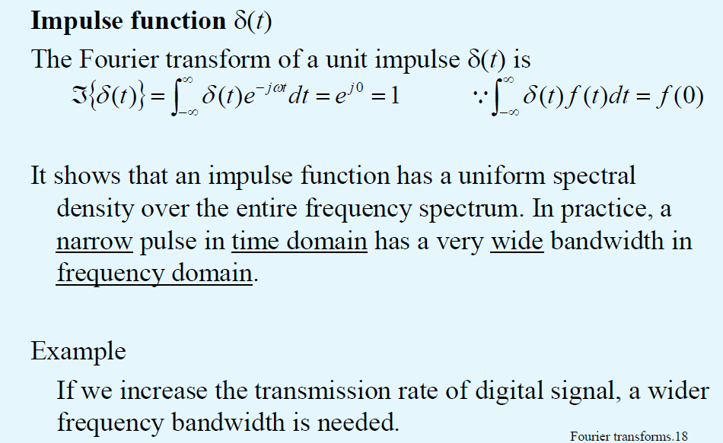
Fourier Transforms of some signals

Slide 24
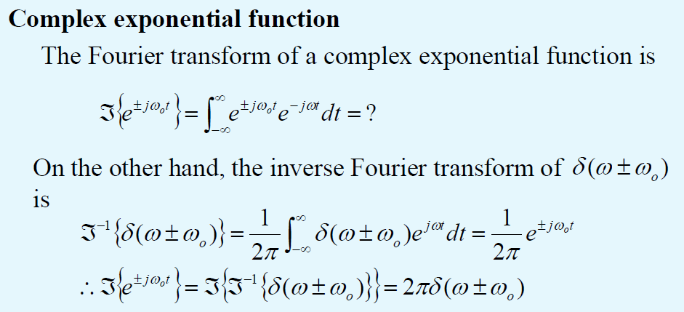
Fourier Transforms and Inverse FT of some signals

Slide 25
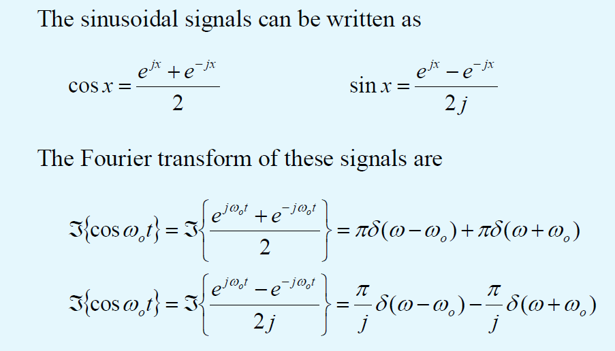
Fourier Transforms of Sinusoidal Signals
F
F(sin

Slide 26
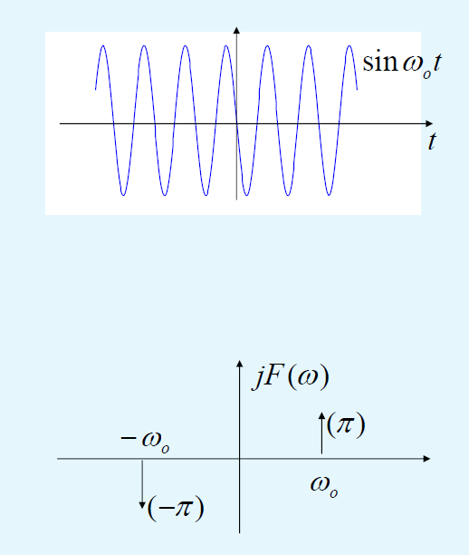
Fourier Transforms of Sinusoidal Signals
Sinusoidal Signals
Which illustrates the last formula from the last slide (for sinus)

Slide 27
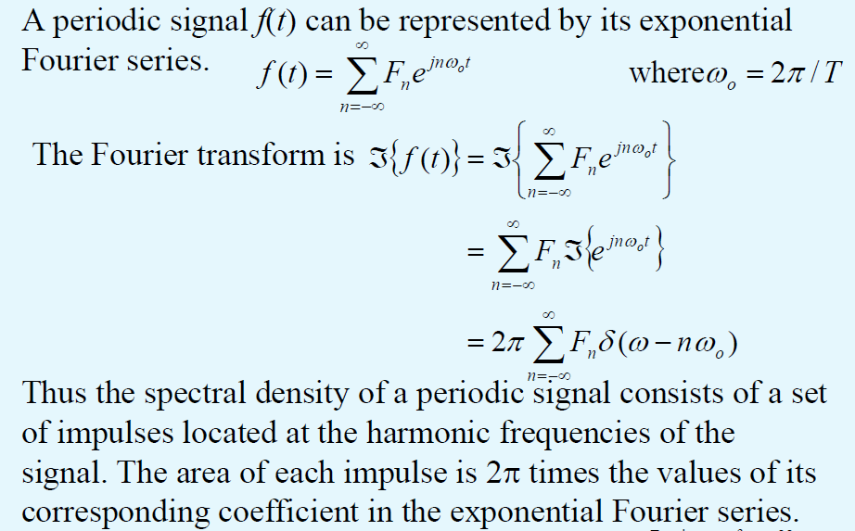
Periodic Signal
Fourier Transforms of a Periodic Signal

Slide 28
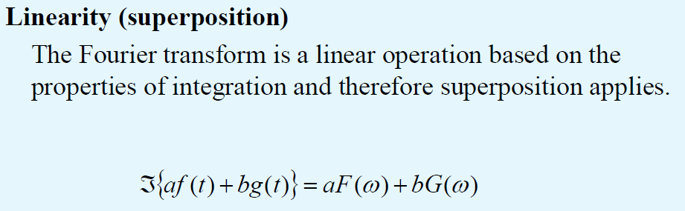
Some properties of the Fourier Transform
Linearity

Slide 29
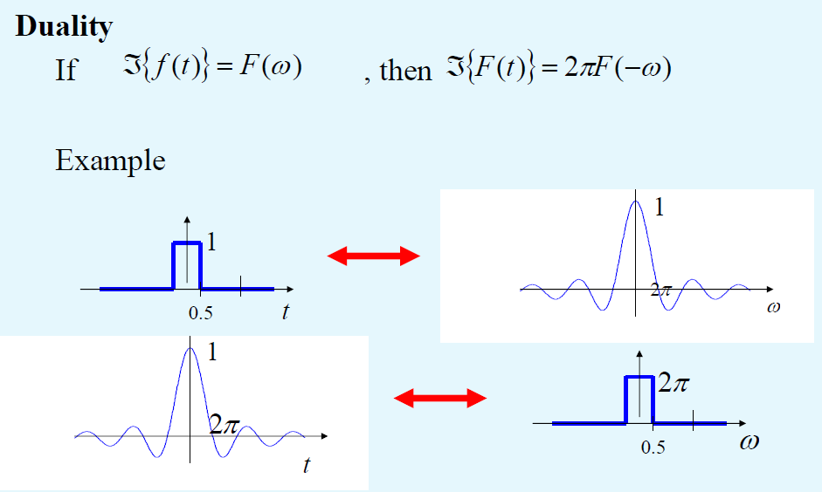
DUALITY
Some properties of the Fourier Transform
Spectral domain
Time domain

Slide 30
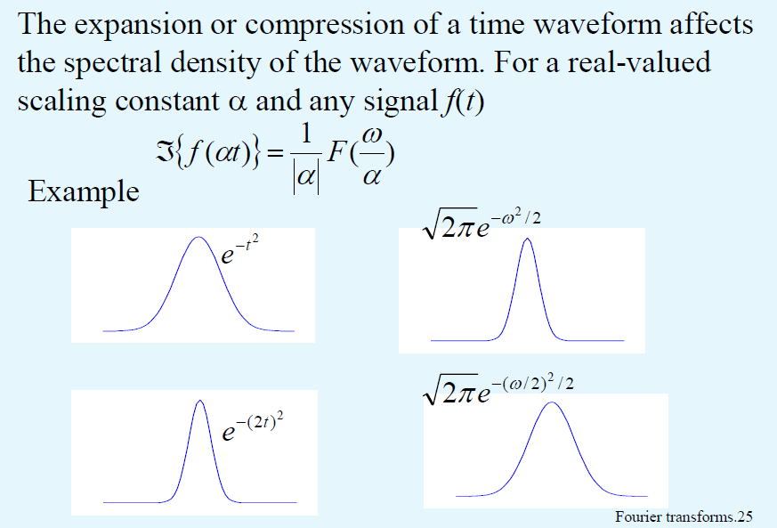
Coordinate scaling
Spectral domain
Time domain

Slide 31
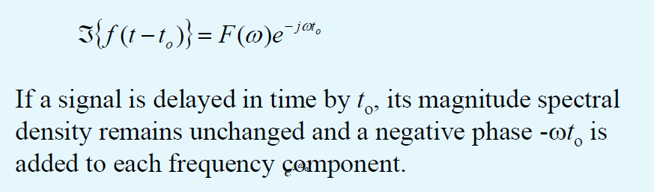
Time shifting.
Transforms of delayed signals
Add negative phase to each frequency component!

Slide 32
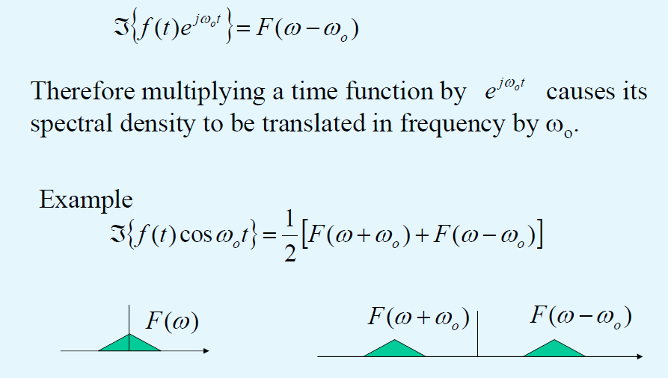
Frequency shifting (Modulation)

Slide 33
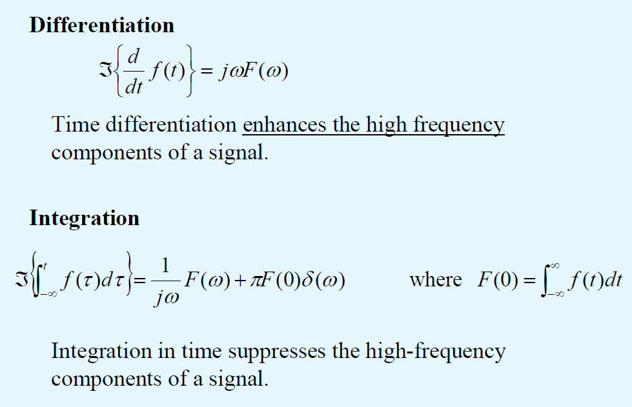
Differentiation and Integration

Slide 34
These properties have applications in signal processing (sound, speech) and also in image processing, when translated to 2D data

